Slide 1
Screen Time Management
Dr. Bonnie Huang Hall, MD PhD
Board Certified Family Medicine
ACOG, AAFP
Mother of three school age kids at Laneview and Morrill Middle school

Slide 2
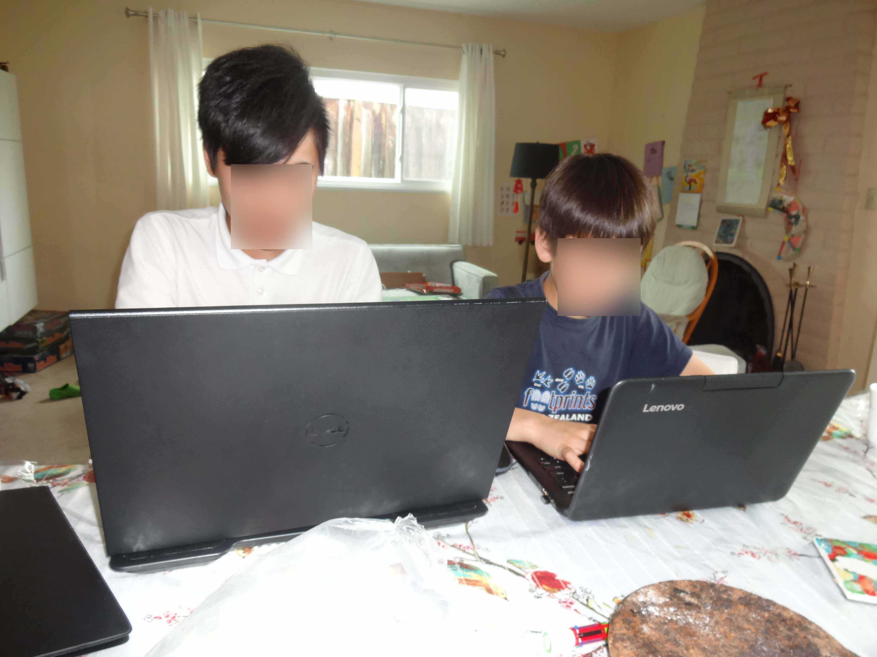
Screen Time : It’s an Epidemic!
75% of US teenagers today own a smart phone
76% of teenagers use at least 1 social media site
25% teens “constantly connected” to the internet.
84% of boys report playing video games online or on a cell phone.
96% of 2 year olds from Low Income families have used a mobile device.

Slide 3
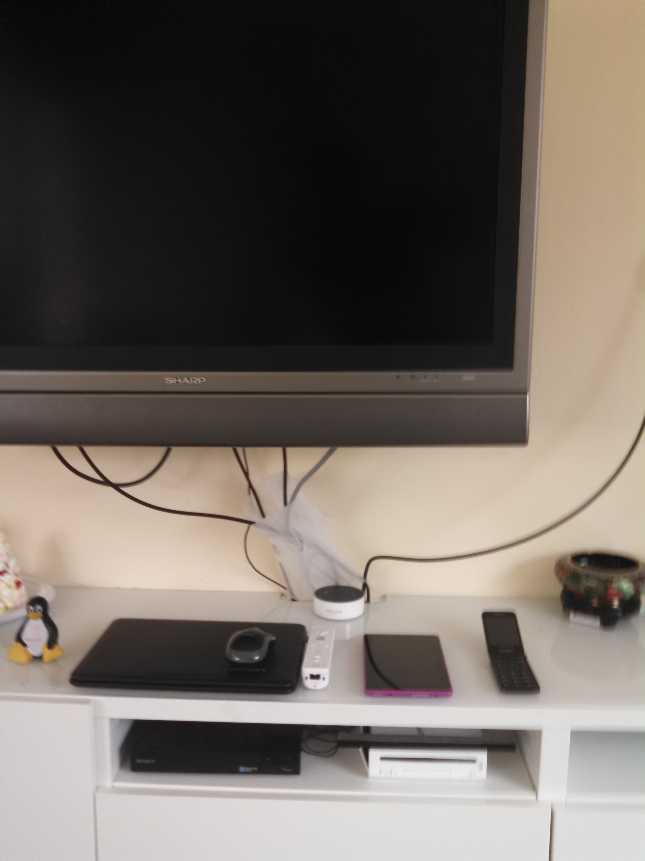
Screen time usage and devices
Entertainment: tv shows, movies, video games
Educational games (Jiji)
Communication: Texting, video chatting
Social media: facebook

Slide 4
Good and Not so Good
Educational
Jiji, PBS, researching topics online
Communication
Video chatting with distant relatives
Making friends
Development identity
Social media
Marketing
Commercials, alcohol, materialism
Communication
Bullying / “Drama”
Harmful Exposure
Violence, Sex, bad language

Slide 5
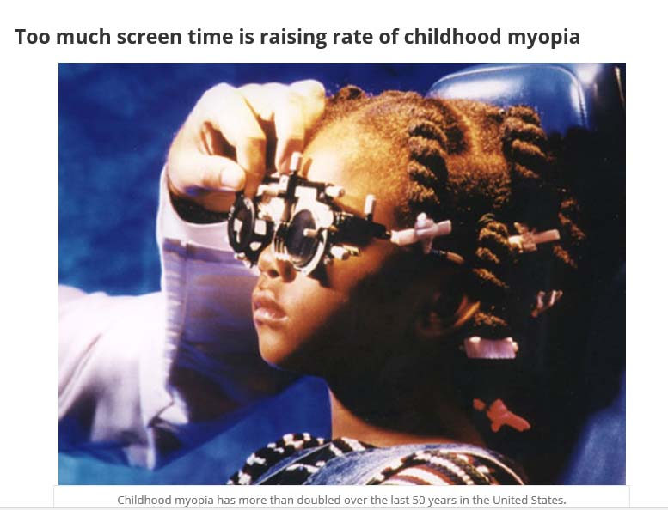
Negative Health Effects
Obesity
Sleep
interruption
Depression
“Text Neck”
Myopia
Decreased life
satisfaction
New Disease: Internet Gaming Disorder.
https://keck.usc.edu/too-much-screen-time-is-raising-rate-of-childhood-myopia/

Slide 6
Internet Gaming Disorder 2015
Preoccupation: spending lots of time thinking /fantasizing about playing game
Tolerance: need more time to feel satisfied about playing game
Withdrawal: cutting down feel restless/angry, frustrated, anxious
Persistence: enduring desire to play game and unsuccessful attempts to stop /reduce
Escape: plays to escape from negative mood states
Problems: continued gaming despite being aware of negative consequences of behaviors
Deception: lying to others covering up extent of gaming behaviors
Conflict: losing /nearly losing an important relationship of opportunity related to schooling or employment due to gaming

Slide 7
What can we do??
American Academy of Pediatrics:
Recommends 2 hours of screen time a day or less (including educational time)
Family / Grandparent/ parental involvement and supervision

Slide 8
Family Media Plan
Screen Free zones: bedroom, dining area/kitchen
Screen Free times: homework, 1 hour prior to bed, meal times, walking
CO- View, Co-play
Rules about media: no downloading/website without permission, playing games against family values, talking to strangers online

Slide 9
Family Media Plan
Opportunity cost of screen time: (instead of reading, playing outside/with friends, hobbies)
Manners: no texting /phone use while person is talking to you
Digital Citizenship: no bullying others/posting about others, reporting uncomfortable events
Safety: do not give out personal info, phone number, strangers

Slide 10
V Chip
All shows are rated now. TV bigger than 13” have this feature.
TV rating system:
TV Y: ok for 2-6
TV Y7 ok for 7+
TV Y7 FV: has fantasy violence
TV G suitable for all ages
TV PG : parental guidance is recommended
TV 14: unsuitable for under 14
TV MA: mature/adult audiences. Maybe unsuitable for children < 17

Slide 11
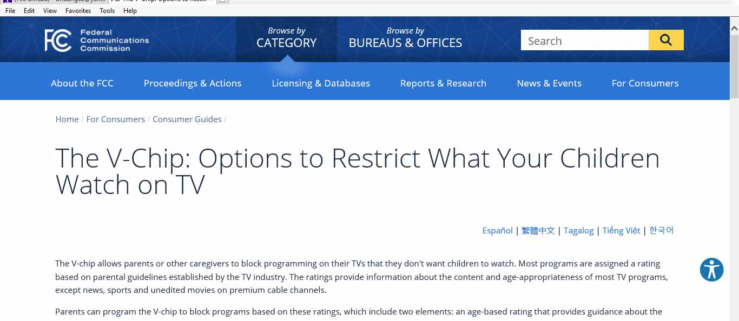
How to set up V CHIP at home
(Google FCC V CHIP)

Slide 12
Parenting is tough-Take Control !
Enforce Screen time!
Make it a priority
Rewards for good behavior!

Slide 13
Sources
Family Media Plan Sponsored by American Academy of Pediatrics:
https://www.healthychildren.org/English/media/Pages/default.aspx#wizard
http://pediatrics.aappublications.org/content/pediatrics/early/2016/10/19/peds.2016-2592.full.pdf

